Slide 1
IELTS Preparation Writing Task 1
Created by Dianne St Clair

Slide 2
What is IELTS?
International English Language Test System
the world’s proven English test
Speaking
Listening
recognized by more than 7,000 institutions in over 135 countries
IELTS
over 700,000 people from over 120 countries take this exam every year
Writing
Reading
managed by the British Council, IDP: IELTS Australia and the University of Cambridge ESOL Examinations

Slide 3
Writing Tasks
Writing Task 1
IELTS
Writing Tasks
Writing Task 2
Add text in here
Graph/
Diagram
Essay
150 words or more
describe, summarize, or explain:
a process or
how something works or
an object or event
250 words or more
write an essay in response to a point of view, argument or problem

Slide 4
Writing Task 1
Write a report based on pictorial information
you may need to describe a graph, chart, or diagram
you might also be asked to describe the process shown by the diagram.
A
January 1,500 (15%)
B
February: 1,500 (15%)
C
March 6,000 (60%)
D
April : 1,000 (10%)
Total : 10,000 (100%)

Slide 5
Want a High Score?
Topic Development
1
2
Sentence Structure/
Mechanics
Find the Main Idea
to describe the patterns/trends.
Group relevant information.
Express ideas in complex sentences
Use correct spelling, punctuation, etc.
Convey your ideas in a structured essay/letter
Use only relevant information
Use appropriate vocabulary to describe trends
Organize/
Support
Word Choice
3
4
You will be scored on your ability to follow this criteria

Slide 6
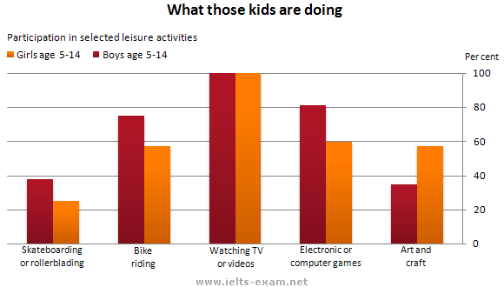
Writing Task 1
Study vocabulary
Use strong VOCABULARY
Review vocabulary lists to successfully portray your ideas and describe trends.
Identify the Main Idea
Categorize and express only the relevant information
Describe the data accurately
Find the MAIN IDEA
Find the TRENDS
What has happened?
Review Sample Answers
Group the relevant information and find the patterns
Study
EXAMPLES
Be familiar with sample answers so that you can present your information in a formal, academic manner.

Slide 7
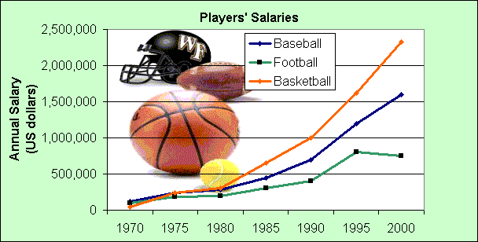
Let’s Begin!
STUDY THE GRAPH
Underline KEY WORDS
find related words (synonyms, antonyms, etc.)
HIGHLIGHT the graph
Make notes of the biggest, the smallest, the stable and changing parts, etc.
Source: from The First Measured Century, by PBS
Most IELTS exams have graphs
with two trends, or two graphs
with a trend in each.
You could write about the two trends in
two separate paragraphs
Be sure to identify the trends in the graph. If you don’t, your will not score a Band 6.
Identify TRENDS
Overall, what is happening? What is the main change, pattern, or most noticeable event over time?

Slide 8
Getting the MAIN IDEA

Slide 9
Getting the MAIN IDEA
DO
Find one main idea and, if possible, one or two more smaller ideas.
Find the main features of the graph.
What is happening?
What are the biggest
numbers?
What are the biggest
changes?
What are the trends?
What are the high and
low points, averages?

Slide 10
Getting the MAIN IDEA
DON’T
Don’t analyze or explain everything in the graph.
Don’t mention the small or unimportant details.

Slide 11
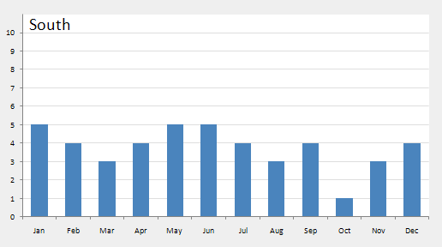
Vocabulary
There are special words for numbers, fractions and percentages.
1990 | 1995
1200 | 1800
The number went up by 600, from 1200 to 1800. (Number)
The figure went up by 50%, from 1200 to 1800. (Percentage)
The number went up by half, from 1200 to 1800. (Fraction)

Slide 12
Getting the MAIN IDEA
DETAILS
All salaries increased
Big differences between
1970-2000 for all sports
Basketball was biggest in
2000, followed by baseball
In 1970, basketball was
the lowest, baseball was
the highest
There was a sudden rise
beginning in 1980
There was another sharp
rise for all sports in 1990
Salaries in football began
to level off or even fall
from 1995 onwards
The MAIN IDEA
The graph shows US sports players salaries in dollars. In 1970, baseball players earned $125,000 a year, football players’ salaries averaged $99,000 a year, and basketball players earned about $43,000 annually.

Slide 13
GROUPING Information
Sometimes there is just too much information in a graph.
You may need to group information.
Put two or three similar or related things together. This makes it easier for the reader to understand. It is also less work for you, because you can put more than one piece of information in a sentence.
For example, you might be able to divide a list into three groups. Often there is one group at the top, one in the middle, and one at the bottom.

Slide 14
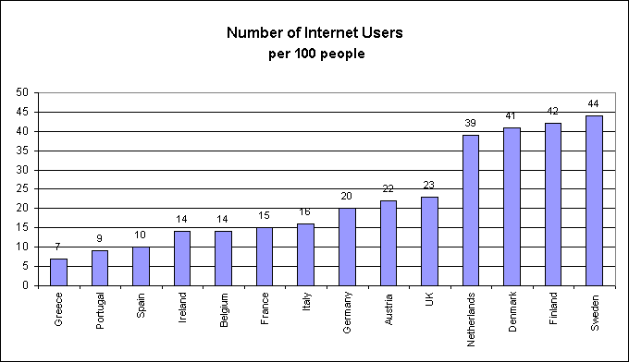
GROUPING Information
This graph shows the number of Internet users
in European countries in 2000.

Slide 15
GROUPING Information
Group 1
Finland, Sweden, Netherlands, and Denmark (about 40 users per 100)
Group 2
Germany, Austria, UK (about 20 to 25 users per 100)
Group 3
Ireland, Belgium, France and Italy (14-16 users)
Group 4
Spain, Portugal, Greece (less than 10% Internet users)
Notes:
This involves describing the data accurately, pointing out trends and relevant information, and using appropriate vocabulary.

Slide 16
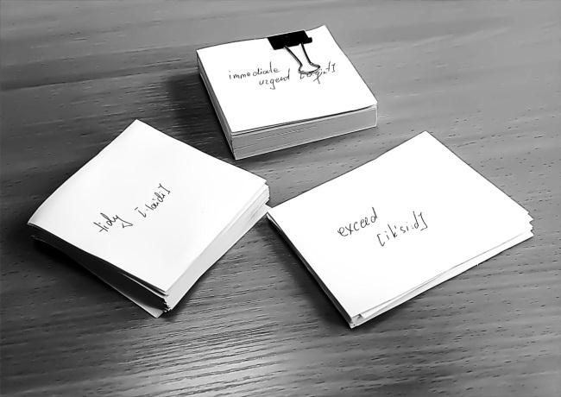
Vocabulary
You will need to understand and be able to use a large number of words to do well in all sections of the exam. If you are doing the Academic version of IELTS, you should study the words in the Academic word list

Slide 17
Vocabulary
Don’t repeat verbs
Before you write, make a list of synonyms
for the key words
See how many ways you can rephrase the
title of the graph. Use one in the
introduction and another in the conclusion
Be careful with prepositions. They can make a big difference in meaning. For example, “rose by” is very different from “rose to.”

Slide 18
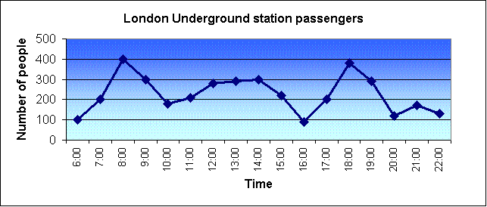
Vocabulary
Example
The graph shows the fluctuation in the number of people at a London underground station over the course of a day.
The busiest time of the day is in the morning. There is a sharp increase between 06:00 and 08:00, with 400 people using the station at 8 o'clock. After this the numbers drop quickly to less than 200 at 10 o'clock. Between 11 am and 3 pm the number rises, with a plateau of just under 300 people using the station.
In the afternoon, numbers decline, with less than 100 using the station at 4 pm. There is then a rapid rise to a peak of 380 at 6pm. After 7 pm, numbers fall significantly, with only a slight increase again at 8pm, tailing off after 9 pm.
Overall, the graph shows that the station is most crowded in the early morning and early evening periods.

Slide 19
IELTS Preparation Writing Task 1 Good Luck!
Created by Dianne St Clair

