Slide 1
John Steinbeck
By: Sam, Anni,Truman, Alex

Slide 2
John Steinbeck
Was born on February 27, 1902, in Salinas, California
An American author
Nobel Prize in Literature and the Pulitzer Prize

Slide 3
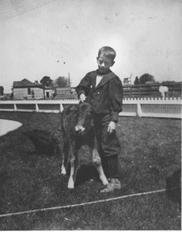
Aspects influenced Steinbeck's works
Salinas East of Eden
Pony The Red Pony
The Death of Arthur Tortilla Flat

Slide 4
Family Background
John Steinbeck’s father was a bookkeeper.
His mother was a school teacher and obsessed in arts. Therefore, he got a love of literature.
He had a happy childhood life, growing up with his three young sisters.

Slide 5
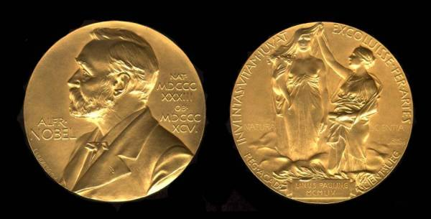
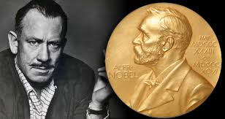
Nobel price in literature
Awarded in 1962 to John Steinbeck
Realistic and Imaginative writings
Keen social perception
Sympathetic humour

Slide 6
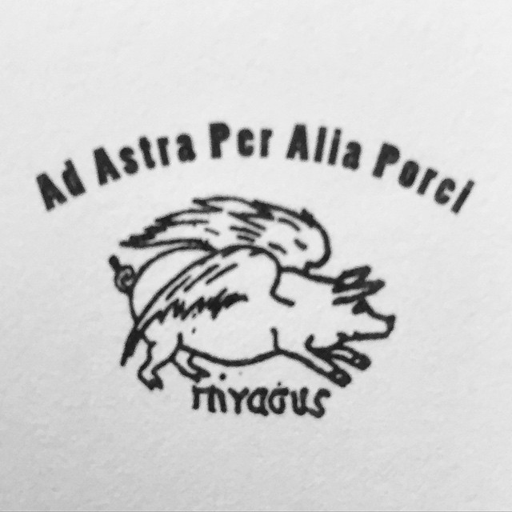
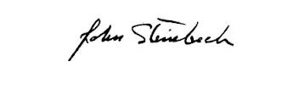
Special Signature
He liked to sign his books with a winged pig drawing name “Pigasus”.
This pig would remind him that a man should never give up.

Slide 7
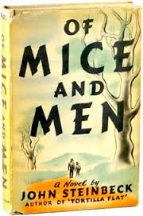
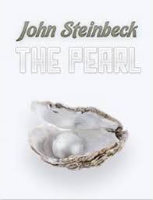
Famous Novels
“The Grapes of Wrath”
“The Pearl”
“The Moon is down”
“East of Eden”
“The Winter of Our Discontent”

Slide 8
Why did he write this book“Of Mice and Man”?
His early life in farming towns strongly influenced his way of writing.
He saw the lives of ranch workers all the day, which inspired him to create the two main characters George Milton and Lennie Small.
Sympathy towards poor migrant labors was showed in this book.

Slide 9
Bibliography
"Nobel Prize in Literature (1901 – 2014)." Tomas Transtrmer. N.p., 22 Oct. 2011. Web. 17 Aug. 2016.
John Steinbeck Biography. N.p., n.d.
"Controversy Over Steinbeck's Nobel Prize Resurfaces." LitReactor. N.p., n.d. Web. 17 Aug. 2016
"National Steinbeck Center." John Steinbeck Biography ::. N.p., n.d. Web. 18 Aug. 2016.
Bio.com.A&E Networks Television, n.d. Web. 17 Aug. 2016.
"John Steinbeck Biography." Bio.com. A&E Networks Television, n.d. Web. 17 Aug. 2016.
Shmoop Editorial Team. "John Steinbeck: Biography." Shmoop. Shmoop University, Inc., 11 Nov. 2008. Web. 18 Aug. 2016.
Mcbride, Walter. "What Influenced John Steinbeck to Write "Of Mice and Men"?" Reference. N.p., n.d. Web. 17 Aug. 2016.
"What Inspired John Steinbeck to Write?" Reference. N.p., n.d. Web. 17 Aug. 2016.
"The Pearl." Book Notes. N.p., n.d. Web. 18 Aug. 2016
"Bantam Books 7 - John Steinbeck - The Grapes of Wrath." Flickr. Yahoo!, n.d. Web. 18 Aug. 2016.

